Slide 1
Gramener Case Study
Submission By –
Ankur Verma
Piyush Kaushal
Aayushi Aggarwal
Sumit Gulati

Slide 2
Standard Process for Data Mining
Business Understanding
Data Understanding
Data Preparation
Modeling
Evaluation
Deployment

Slide 3
Business Objectives
Identification of Loan Applicant traits that tend to default paying back.
Understand the ‘Driving factors’ or ‘Driver Variables’ behind the Loan default phenomena.
The finance company may choose to utilize this knowledge for its portfolio nd risk assessment of new loan applicants.

Slide 4
Data Understanding
The company has come across some important attributes in order to understand behavior of their approved loan customers w.r.t. loan default. Thus, the lending company has decided to work only on these variables to mitigate the future risk. The driver variables consider for this case study are:
annual_inc - Annual Income of applicant
loan_amnt - The listed amount of the loan applied for by the borrower
funded_amnt - The total amount committed to that loan at that point in time
int_rate - Interest Rate on the loan
Grade - LC assigned loan grade
Dti - Debt to income ratio
emp_length - Employment length in years
Purpose - A category provided by the borrower for the loan request.
home_ownership - The home ownership status provided by the borrower during registration
loan_status - Current status of the loan

Slide 5
Problem Analysis
This data has information about 4 years of loans that has been issued . They are mainly of 3 types – Fully Paid off, Current and Defaulted.
The dataset contains all sort of information about customers like annual income, employment length etc.
ASSUMPTIONS
As current loans have not yet been completed, we decided to ignore them during analysis
Outliers (Based on Annual Income) have not been considered during analysis

Slide 6
Problem Analysis
On high level following are stages in the workflow:
Gather data for the analysis.
Clean and Format the data for readability.
Extrapolate the Derived Metrics.
Filter out the outliers based on Annual Income.
Filter Data Set on Loan Status.
Perform Univariate and Bivariate analysis on the Data.
Plot the results of Analysis and Hypnotize the Root of the Issue.

Slide 7
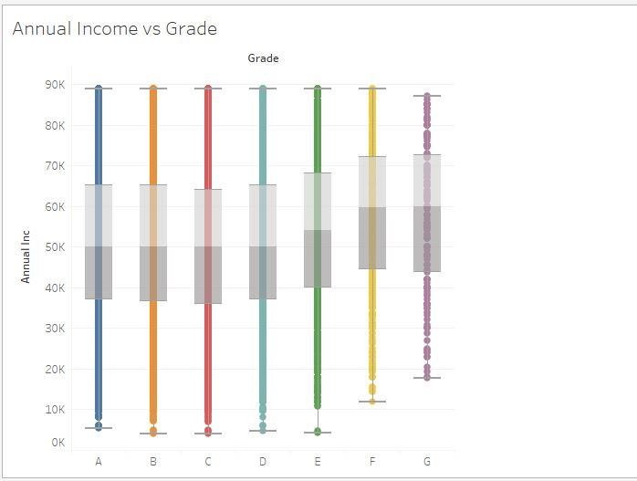
Plots: Annual Income vs Grade
The mean income as well as the
range of the incomes is almost
same across all the grades.
It is a little more for grades E, F
and G.

Slide 8
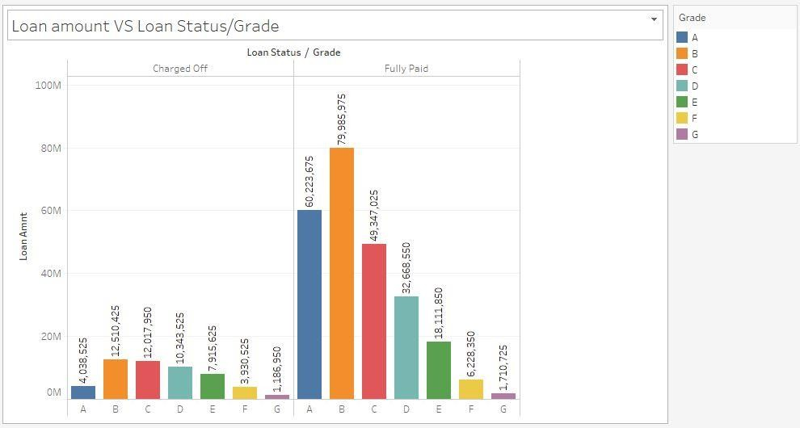
Loan amount vs Loan Status/Grade
The graph is right skewed,
that shows the grades from
D to G follow a decreasing
trend for both Default and
Fully paid.

Slide 9
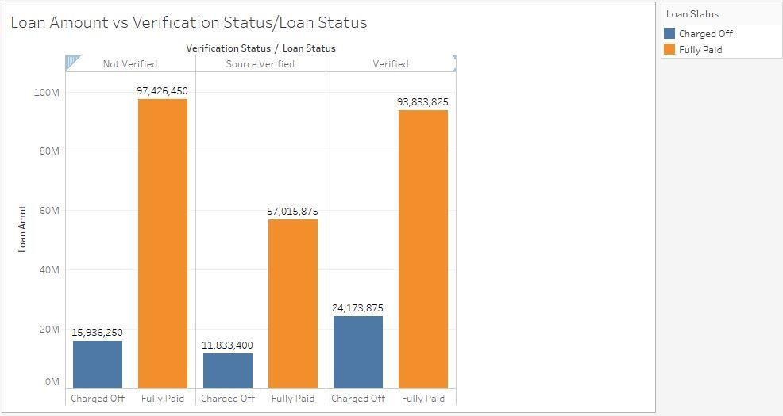
Loan amount vs Verification
We can see here that the number
Of defaults for source verified and
verified are high in number.
We need to investigate whether
the documents have been
correctly identified and verified
before the loan is lent.

Slide 10
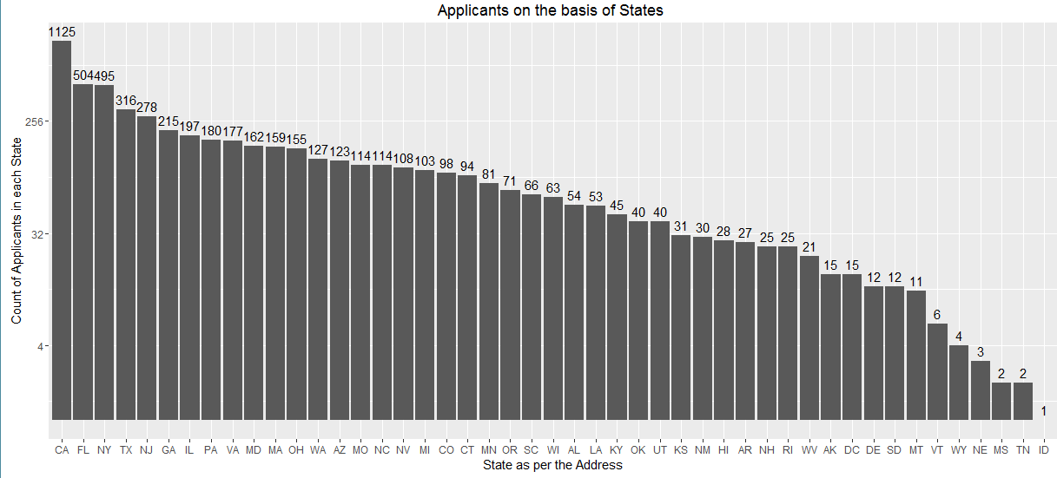
Univariate analysis
Log 2 Power Scale Histogram
Observations: California, Florida, New York, Texas, New Jersey are top 5 affected states with loan status: “Charged Off”

Slide 11
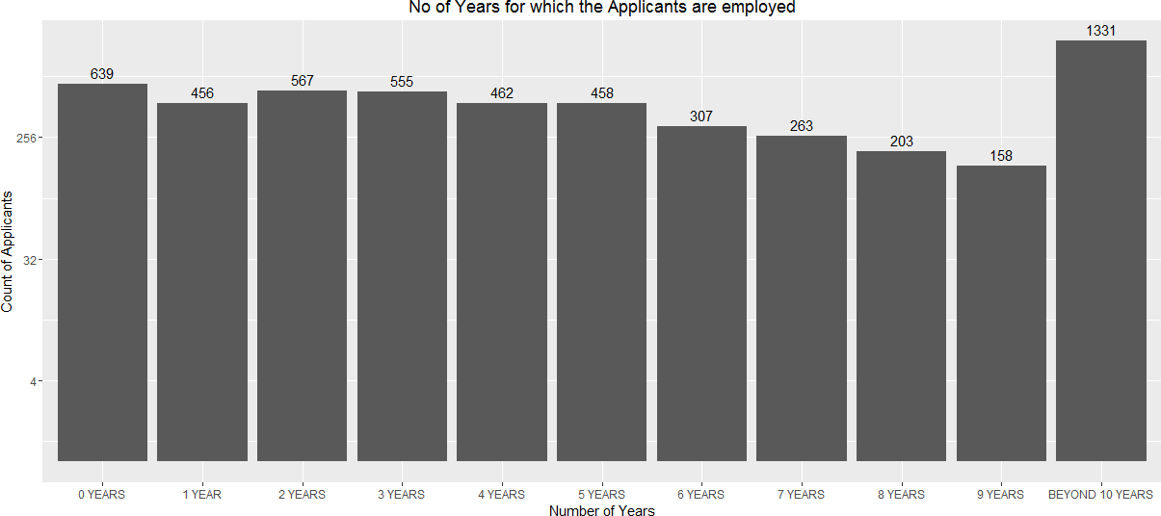
Univariate analysis
Histogram of Employment length in Charged Off Loans
Observations: Charged off loans has a decreasing trend w.r.t tenure. However the number of Charged Off loans within the first year is too high.

Slide 12
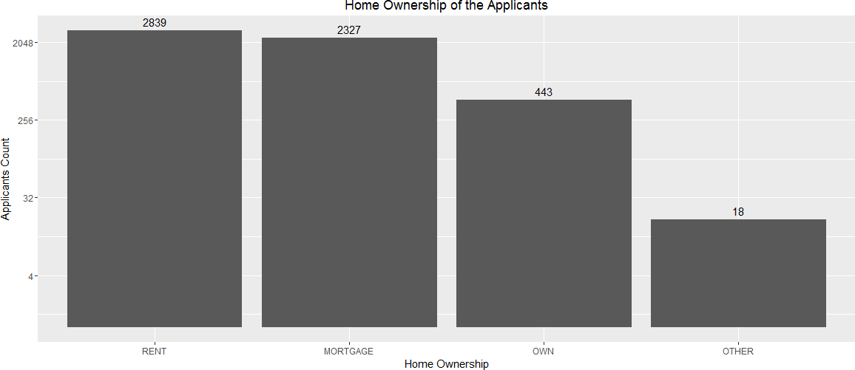
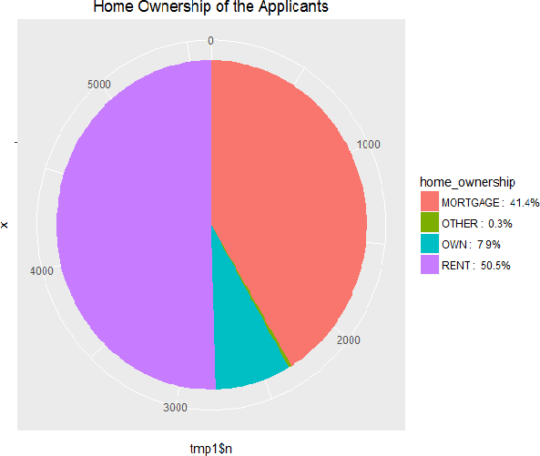
Univariate analysis
Histogram of Home ownership status in Charged Off Loans
Observations: People who live in rented accommodation constitute of 50.5% of the population

Slide 13
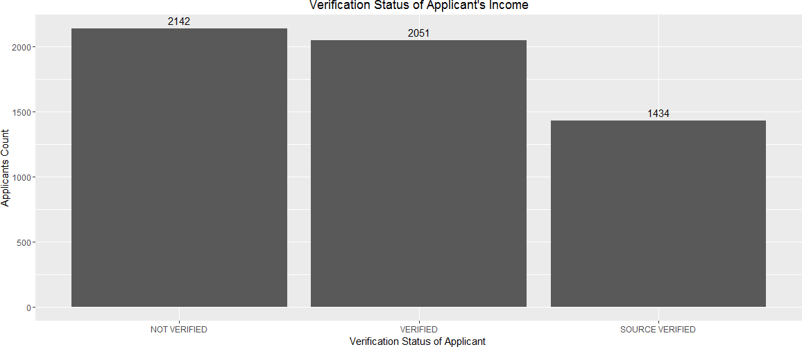
Univariate analysis
. Histogram of Income Source Verification in Charged Off Loans
Observations: When the income source is verified, the Charged Off phenomenon seems to be marginally lower

Slide 14
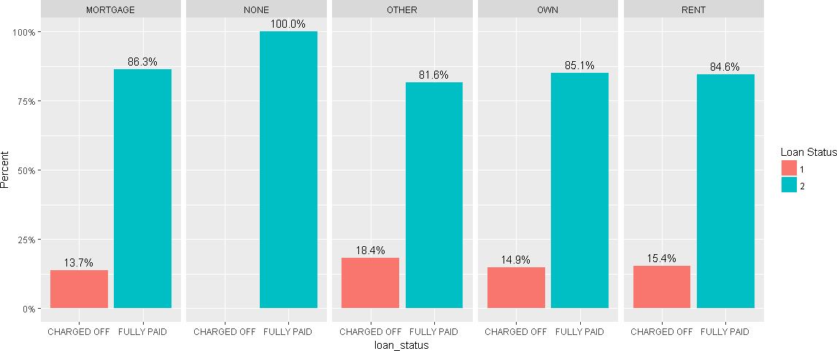
Bivariate analysis
Homeowner Attribute vs. Loan Status
Observation: If the borrower’s home ownership status is “OTHERS”, he is 18% likely to be a defaulter compared to other categories

Slide 15
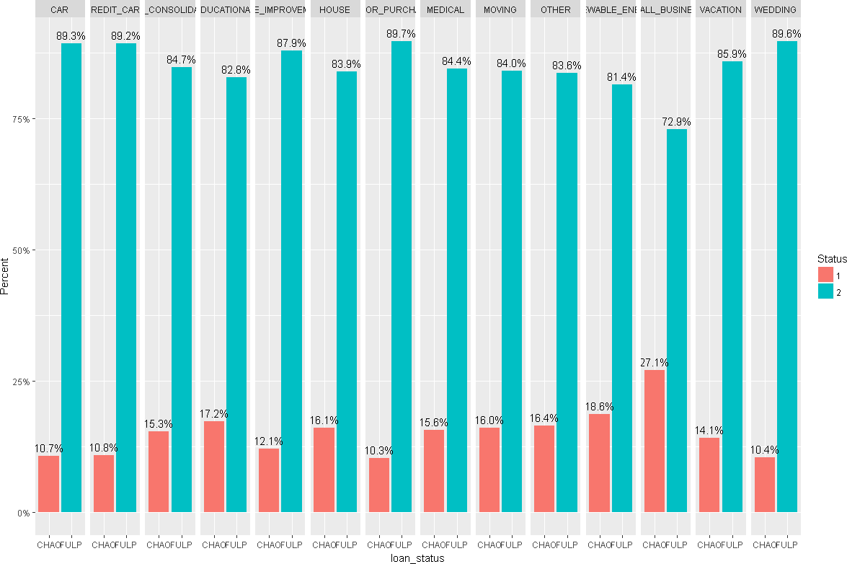
Bivariate analysis
. Purpose Attribute vs. Loan Status
Observation: Borrowers for ‘Small Business’ are most likely to default for the loan compared to other purposes

Slide 16
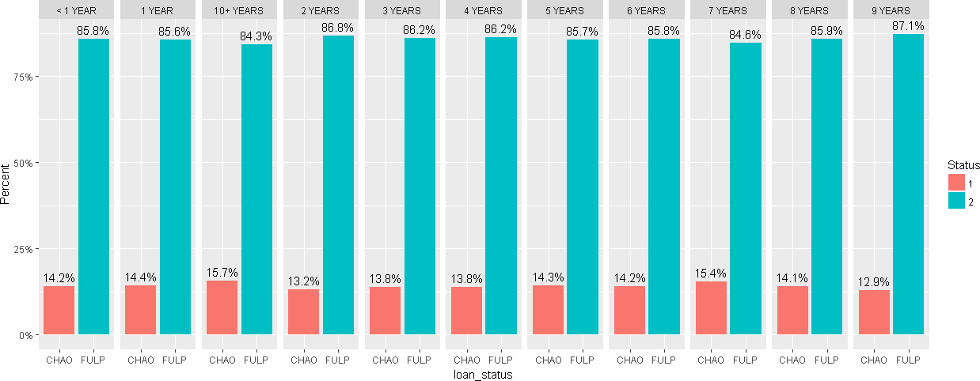
Bivariate analysis
Employment Duration vs. Loan Status
Observation: Borrowers employed for 10+ years are most likely to default the loan compared to other durations

Slide 17
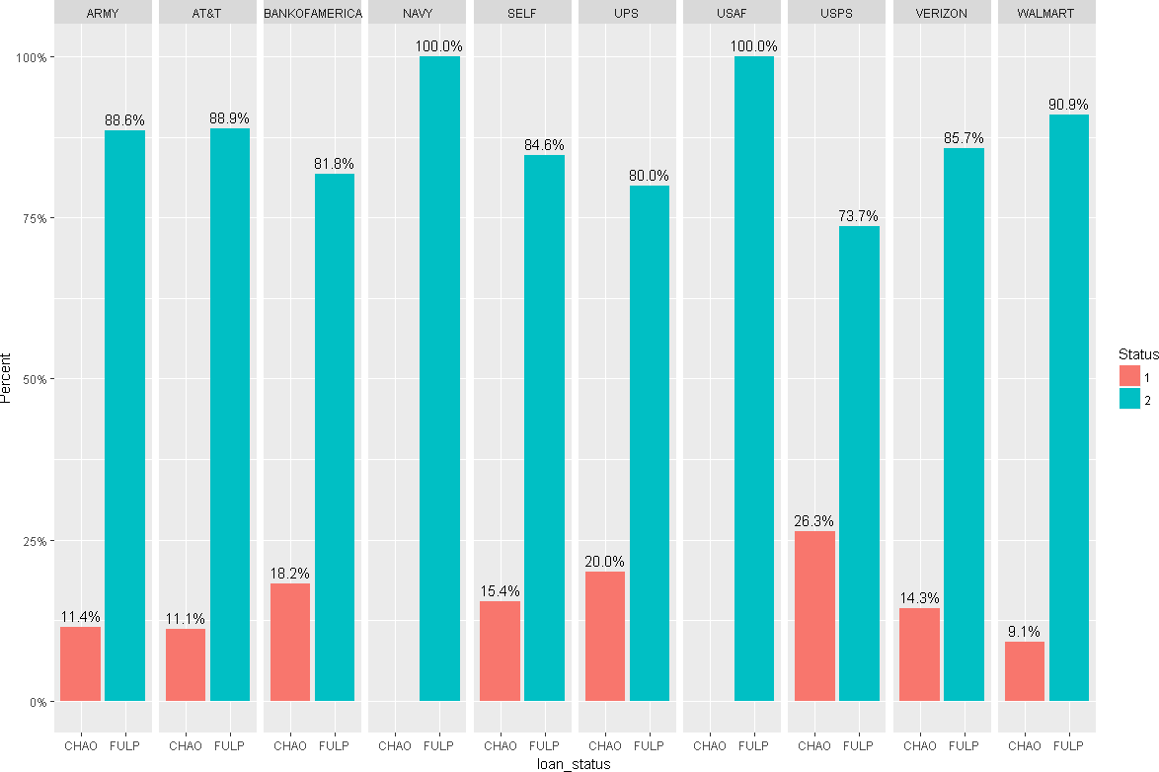
Bivariate analysis
. Top 10 Employers vs. Loan Status
Observation: Employers working in USPS are more likely to default

Slide 18
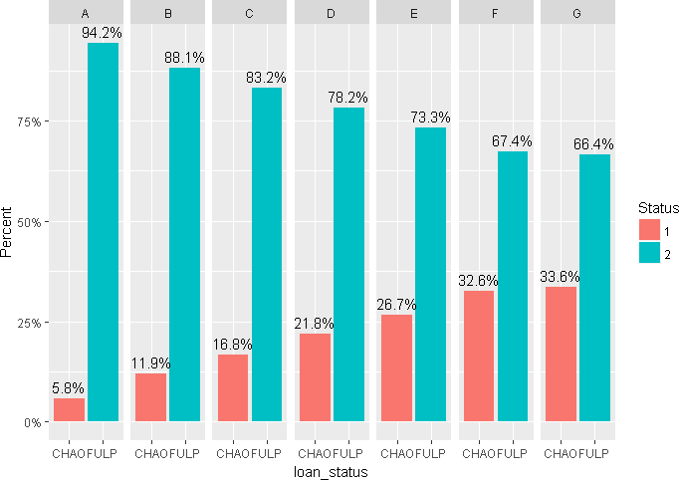
Bivariate analysis
Grade vs. Loan Status
Observation: Loans with Grade as G are most likely to be defaulted

Slide 19
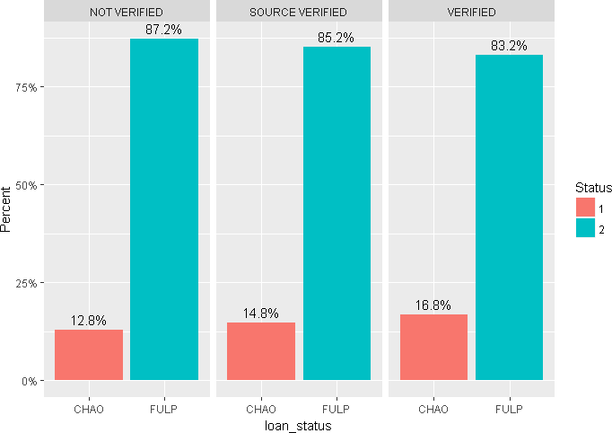
Bivariate analysis
Verification Status vs. Loan Status
Observation: In-spite of verified status, the likelihood of a loan being defaulted is in the “Verified” Category

Slide 20
Conclusion
After examining annual income and grades, we have found that all the grades have almost similar distribution.
Annual Income, interest rate and verification have bearing on whether loan will become fully paid or become charged off. Hence, these parameters need to be critically monitored.
In the current disbursal, from grade D to grade G, the percentage of defaults are more. Grades also play an important role in loan disbursal and repayment and can be reference from current data to make future decisions.
Target based/ last minute loan disbursals should be avoided.

Slide 21
Recommendations
Customer should be classified clearly based on their income, frequency of application, purpose of use, loan duration and intended use based on this interest rate and disbursed amount should be calculated.
The process of income verification should be more accurate as it is a important parameter to control defaults.

